Slide 1


ENDLESS SPACE GLASSES
CHRONICLES OF EXOPLANET EXPLORATION
STAR GIRLS
İpek Gündoğan
Elif Bade Odabaş
Sadem Deren Nalbant

Slide 2
Contents
Summary
What is Exoplanet?
Needs of Space Glasses?
Materials of the Glasses?
References

Slide 3
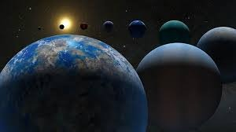
Summary
In this project, we researched extraplanetary space exploration and designed glasses to facilitate these explorations. Using these glasses, astronauts can make extraplanetary space explorations.

Slide 4
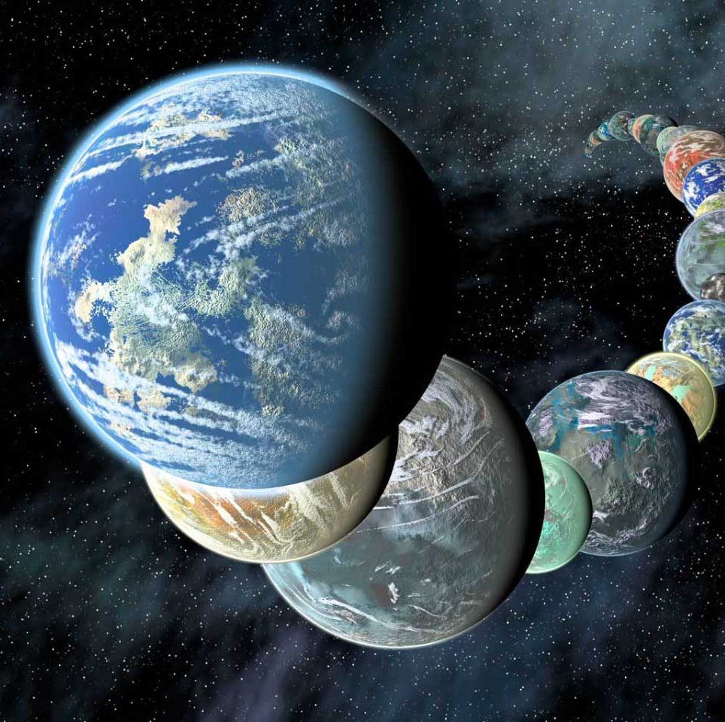
What is EXOPLANET?
An exoplanet is any planet beyond our solar system. Most of them orbit other stars, but some free-floating exoplanets, called rogue planets, are untethered to any star. We’ve confirmed more than 5,600 exoplanets out of the billions that we believe exist.

Slide 5

Let’s Watch a Video

Slide 6
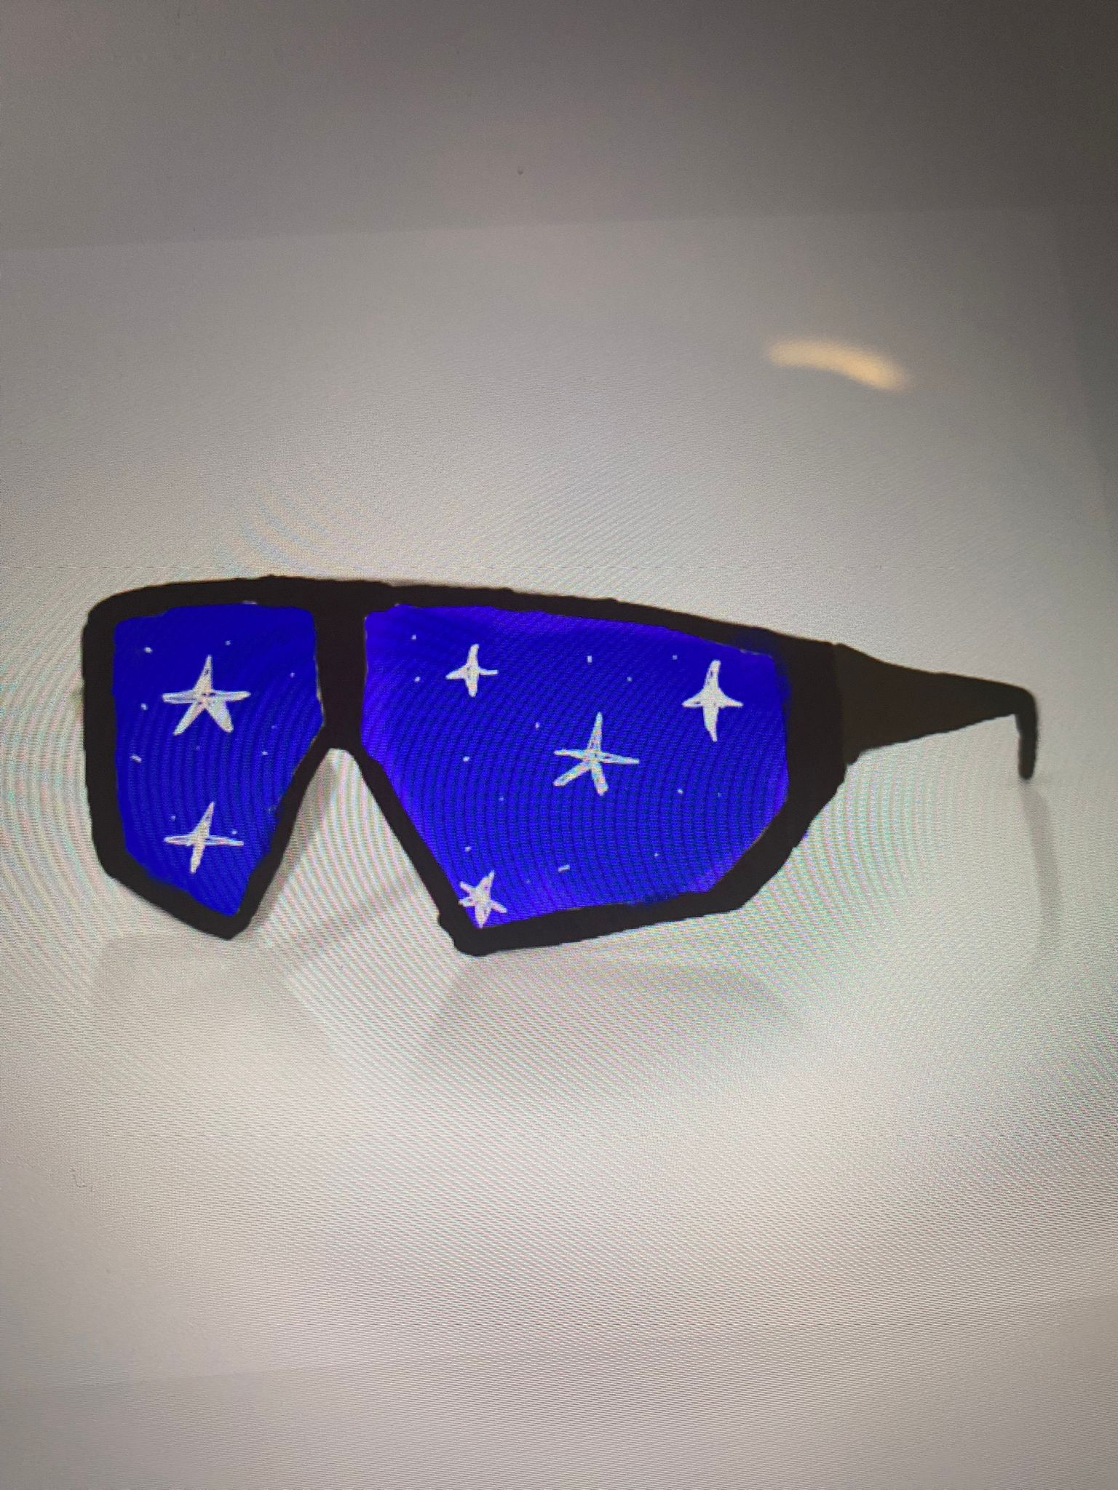
The Materials of the Glasses
What materials are using in space?
Astronauts use materials that reflect sunlight, such as nylon, aluminum and neoprene, in space. These materials must be resistant to high temperatures and hard objects. So, we designed a pair of glasses using these materials.
We used mirrors in these glasses, just like in the Hubble space telescope. In addition, these glasses can see beyond the solar system and exoplanets. It can also show the color and size of these planets.

Slide 7
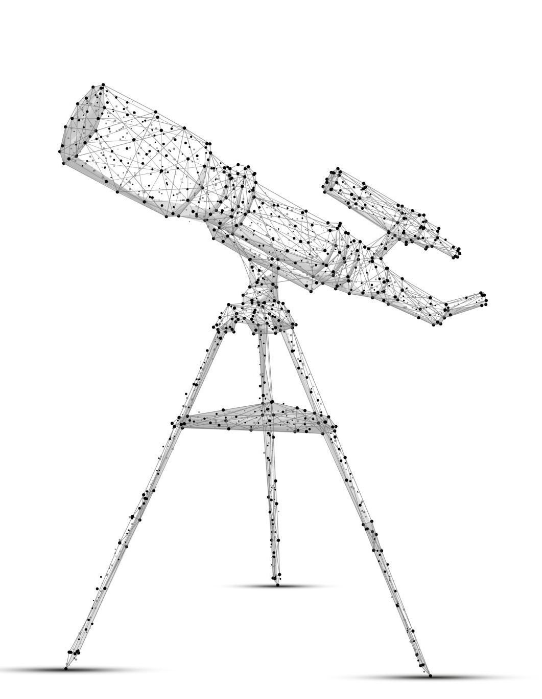
References
It is difficult to observe exoplanets directly with a telescope. Because they are not visible behind the bright light of the stars.
Space telescopes like Spitzer and Hubble have been used to discover exoplanets and reveal more information about what they're like.
https://science.nasa.gov/exoplanets/
https://services.tubitak.gov.tr/
https://tua.gov.tr/tr/

